Slide 1
CO2 EMISSIONS
UNEARTHING THE ENVIRONMENTAL IMPACT
OF HUMAN ACTIVITY : A GLOBAL CO2 EMISSION ANALYSIS

Slide 2
Team
M.Snega
A.Harini
N.Rajeswari
R.Prathisha

Slide 3
CO2 EMISSION
CO2 Emission refers to the Carbon Dioxide emitted throughout the world. For this analysis we will be focusing on CO2 Emissions and its effect on the world we live in as well as some key factors and stats that may play a role in the emission of CO2 globally. Fossil fuel use is the primary source of CO2. The data throws light onto how much fossil fuels are burnt, per year per nation, which amounts to an increase in CO2 every year. This will help researchers and environment experts to predict global warming. So countries should set a goal to decrease this amount yearly.

Slide 4
Dataset consists CO2 emissions in metric ton per capita of every country around the world. The data is collected from 1975 to 2020.
Country- Country for which Co2 is Recorded
Year- Year the data was recorded
Co2 Emission (In Million Metric Tons )
Co2 Growth per Capita
Co2 Per Capita
Cumulative Co2
Several Fossil Fuels rate of Emission

Slide 5
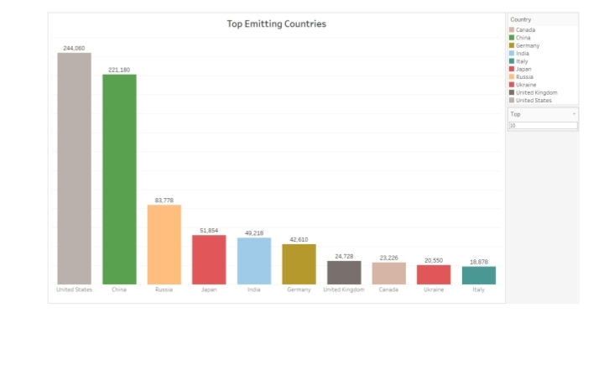
Top emitting Countries

Slide 6
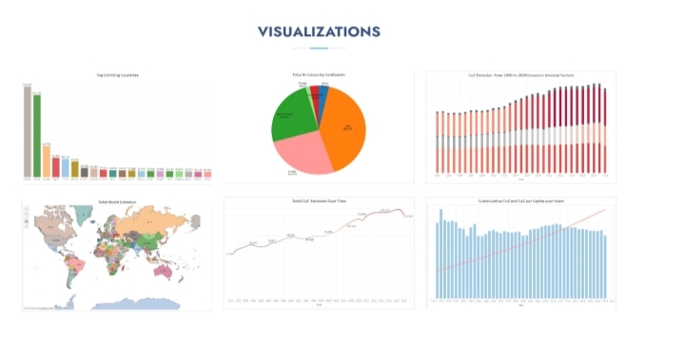
Visualization

Slide 7
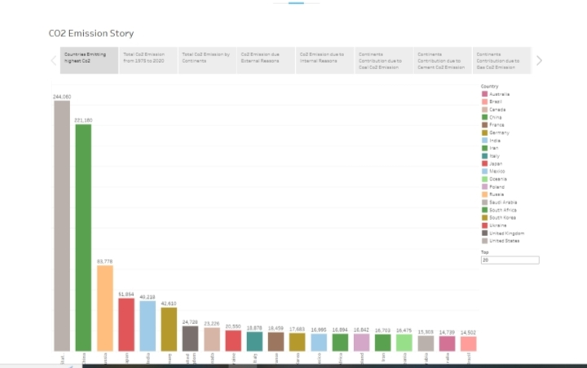
CO2 emission story

Slide 8
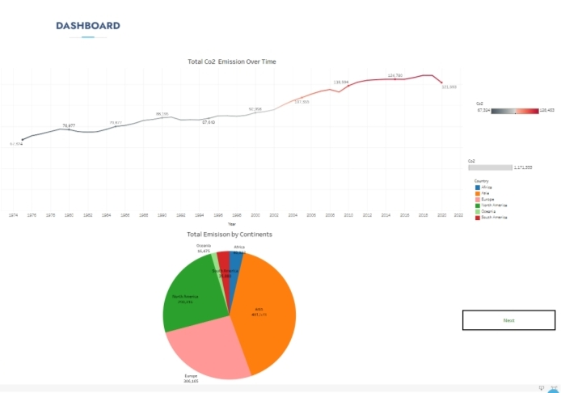
Dashboard

Slide 9
THANK YOU

